Slide 1

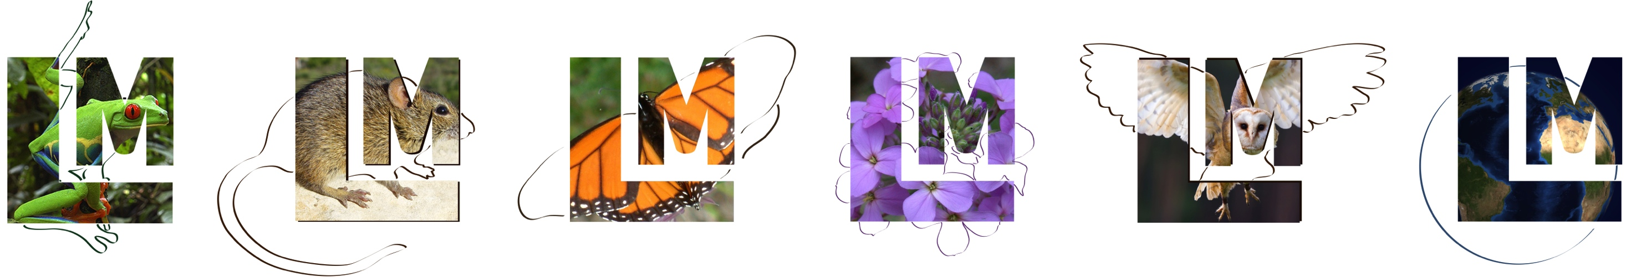
Lifemapper as a Deck of Virtual Components
Aimee Stewart (KU) astewart@ku.edu
Nadya Williams (UCSD) nadya@sdsc.edu

Slide 2
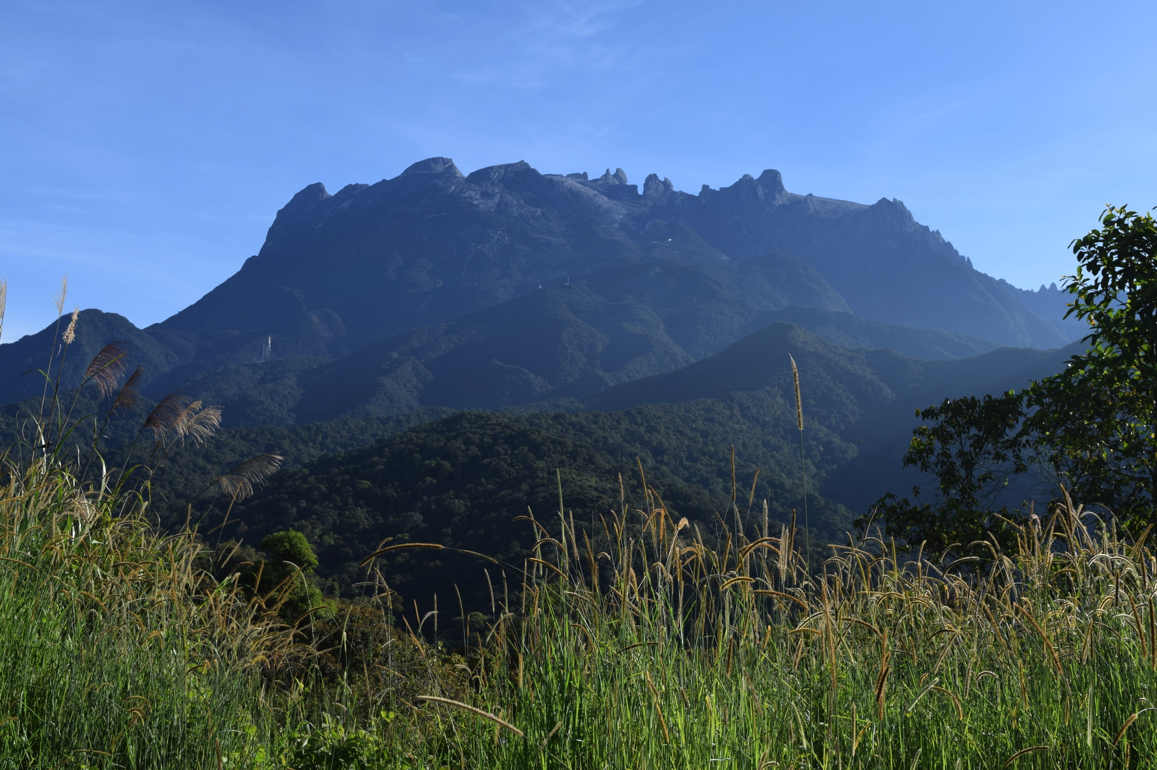
Introduction
VBE goals
Deployable Infrastructure to support Mount Kinabalu research
Background
Mount Kinabalu, Sabah Malaysia
Lifemapper
Progress so far
PRAGMA 23-26 paved the way
ICSE/PRAGMA symposium, UAV data
Notes:
With the VBE, our goal is to create a biodiversity research application that can
support the research of Mount Kinabalu using restricted satellite imagery and sensitive species information.
Our first goal was to be able to use data tied to multiple places,
but we extended our wish-list to be able to deploy on a laptop not connected to the internet.
While that was originally to support field work, we’ve found other uses for this laptop installation, namely for development testing and as a teaching tool.
Mount Kinabalu is a biologically unique area in Sabah, Malaysia,
globally recognized as one of the 6 most biodiverse areas in the world
Extreme environment with a high concentration of ultramafic soils, expressing themselves in unique vegetation color, texture and composition
Lifemapper is a biodiversity research computing infrastructure, providing data and tools over web services for scientists
Open-source, available on Github
tied to Kansas by a lot of legacy code and decisions
Improved a lot as a result of the VBE, and now can be configured and deployed outside of Kansas!
As mentioned, creating and populating the database from scratch hadn’t been done for years, and now we’ve done it, with our own data, multiple times.
Direct benefit of configurability is now we can, with sufficient metadata, install other instances especially for a particular institution, researcher, or dataset
After the prep work done on a Lifemapper installation, the PRAGMA symposium at the ICSE and UAV flights at the same time was another concrete step towards our Mount Kinabalu/Lifemapper installation

Slide 3
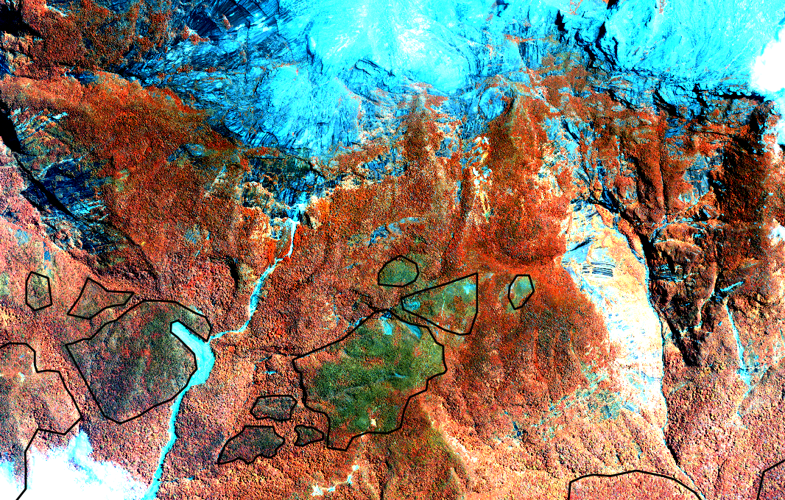
Mount Kinabalu imagery

Slide 4




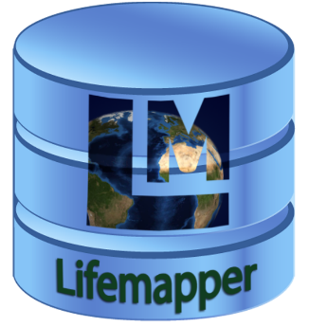
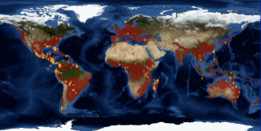

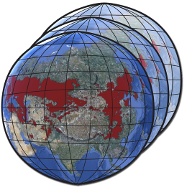
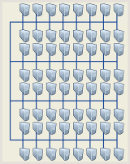
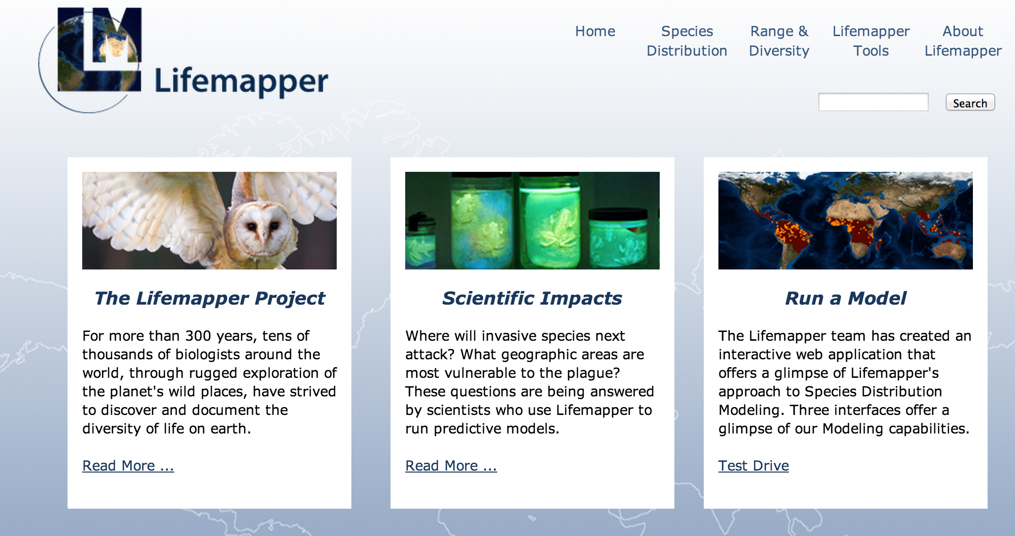
PRAGMA 27 goals and success
Lifemapper server cluster
LmDbServer
Decouple components LmWebServer and LmDbserver from KU-specific implementation
Automate install and configure process
Bootstrap database and metadata seeding
Automate database definition
Automate static input data seeding
Start job pipeline
Reads and inserts dynamic input species data
Creates job-chain for each input species
Connect computational component
Request jobs from LmWebServer
Compute jobs
Return results through LmWebServer
Explore virtualization to enable field work
Pipeline
Species
Climate
Maps & Models
Data updater
Job tracker
Predicted habitat
PAM assembly
LmCompute
Cluster
LmWebServer
External Clients
QGIS, Browser, Python Client
LmSDM
Website
REST Web Services
LmRAD
Visualize, Explore, Analyze
Submit job
Request data
Post result
Notes:
LM is a multi-component system; each component is designed to communicate with the others, but work independently.
Our goal is to have multiple instances of one or more components running for individuals who need Lifemapper.
The components include
LmDbServer – Data and Management Component
LmCompute – Computational Component
LmWebServer - Web Component enables communications between components and clients.
The Client Component includes a website, web services, python app, and QGIS plugin

Slide 5

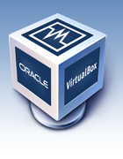
Virtualization Technologies
VirtualBox
Runs on Linux on x86 hardware
Ideal to run on clusters
Advantages in VBE
Can create bigger instance
Can have long running instance
Dynamic input data
Intended for use by multiple external clients
Runs on Linux, Windows, OSX
Ideal for laptops but
Must setup networking
Instance size/memory is limited by laptop hardware
Advantages in VBE
Can special-purpose instance
Can have short-lived instance
Pre-defined stable input data
Intended for field work (with no network connection) and teaching tool
Notes:
KVM (for Kernel-based Virtual Machine) is a
full virtualization solution for Linux
on x86 hardware
First goal for virtualization
VirtualBox is a powerful x86 and AMD64/Intel64 virtualization product
Free and Open Source Software
runs on Windows, Linux, Macintosh, and Solaris hosts
Supports many guest operating systems

Slide 6
Demo: Lifemapper in KVM
Preparation:
rocks-201: virtualized LmCompute at SDSC, compute for Kansas
Automated dependencies and install process
Made configurable
rocks-204: virtualized servers at SDSC, compute for rocks-201
Automated install
Unbound from Kansas - made configurable
Bootstrapped database – big deal!
Configured connections
Demo:
Start LmDbServer pipeline, show output, job results
Start LmCompute, show job progression
Output web services
Notes:
Our first deployment was on KVM
Started with the computational component, already less nailed to KU installation,
and connected it to KU management
Next deployed the server components, big job
Caveat: not a lot of visuals demonstrate a working system
For our demo I’ll show you
Begin data pipeline execution
Changing state of object ready for computation
Start LmCompute job requests
Changing state of object completion

Slide 7

From development to production deployment
Focus: facilitate easy-to-use solutions to provide seamless integration of sw/hw
SW
VM
Complete system
Automate the longest tasks
Use Rocks rolls for software build and configuration
Result
1. Encapsulate difficulty to install and configure applications
2. Know your system real-time status: what is installed, what version, configuration, data
Reuse technology we know
Create Virtual Machines or Virtual Clusters
Result
1. Build Rocks clusters using KVM and VirtualBox
2. Virtualize infrastructure to improve hardware utilization and scalability
3. Deploy virtual servers for efficient and flexible operations
KVM → to VirtualBox
KVM → to EC2
Replicate the resulting VMs
Export VMs
Move VMs with pragma_boot
Result
1. Can enable scientific application running on shared resources (PRAGMA testbed, other)
2. Can use VMs as training and reaching out mechanism
3. Enables cloning multiple servers. Make one time – use many
3. Robust system: can reliably build and rebuild

Slide 8

From to Deck of Virtual Components
this close
KVM: 2 virtual clusters
VBox: 1 virtual cluster
VBox: 2 virtual clusters
rocks-201.sdsc.edu
fe.compute
fe2.public
LmCompute
Cluster
LmCompute
Cluster
LmCompute
Cluster
LmCompute
Cluster
LmCompute
Cluster
LmCompute
Cluster
LmCompute
Cluster
LmCompute
node
LmCompute
Cluster
Lifemapper components
LmDbServer
public
network
private
network
NAT
network
LmWebServer
fe.public
fe.public
LmCompute
rocks-204.sdsc.edu
LmDbServer
LmDbServer
LmDbServer
LmWebServer
LmWebServer
LmWebServer
LmCompute
Notes:
Domain scientist’s viewpoint:
Enable data management (LmDBServer) and web services (LmWebServer) components virtualization
Increase the availability and flexibility of Lifemapper to enable scientists to
Assemble multi-species macro-ecology experiments
Perform other LM-facilitated data processing on: Unique datasets, Restricted use data, Very large datasets
Cyber-infrastructure viewpoint:
Continue practical use of PRAGMA cloud infrastructure
Encapsulate the complexity of software build/configure in ROCKS rolls
Create a complete system as an end-to-end solution
Reduce cost of installing/configuring/replicating

Slide 9
Lifemapper in VirtualBox on a laptop
Import VM
Start VM
Install roll
Bootstrap
database
5 min
3 min
15 min
50 min
Setup
Use
Usage:
Work in field
Development platform
Teaching tool
Notes:
Describe build process: accent on much the same approach.
Start pipeline, show output
Start LmCompute
Run tests?
Run LmWebServer tests (to create viewable output)
Show service URL output in browser

Slide 10
Future Work
VM optimization
Extend
application
Alternative data storage
Training
tool
Cloud approach
Leverage pragma_boot
Heterogeneous, remote, restricted, large datasets
Alternate hardware
Identify required “minimum resources” (memory/disk/network for application)
Create best practices document
Leverage overlay networks
Metadata ingest
Import mechanisms
Reach out to other PRAGMA bio-researchers
Virtual environment testing
Performance estimates
Apply lessons-learned to new applications
Deploy to EC2
Notes:
Heterogeneous datasets
Remote sources
Restricted-use
Very large

Slide 11



Acknowledgements
This work is funded in part by National Science Foundation and NASA grants
PRAGMA
US NSF 1234953
Rocks
US NSF OCI-1032778
US NSF OCI-0721623
Lifemapper
US NSF BIO/ABI 1356732
US NASA NNX12AF45A
USGS CESU #G14AC00285
Notes:
These are all complete?
US NSF BIO/DBI 0851290
US NSF EPSCoR 0553722
US NSF EPSCoR 0919443
US NSF EHR/DRL 0918590
US NSF OCI/CI-TEAM 0753336

Slide 12
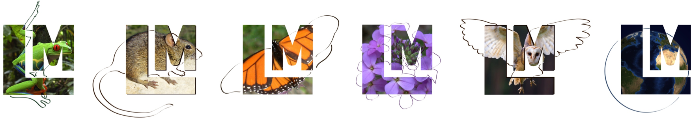

Questions?
Aimee Stewart (KU) astewart@ku.edu
Nadya Williams (UCSD) nadya@sdsc.edu
Lifemapper
http://lifemapper.org
https://github.com/lifemapper/
Rocks
http://www.rocksclusters.org
Pragmagrid GitHub
https://github.com/pragmagrid/lifemapper
https://github.com/pragmagrid/lifemapper-server

